Slide 1
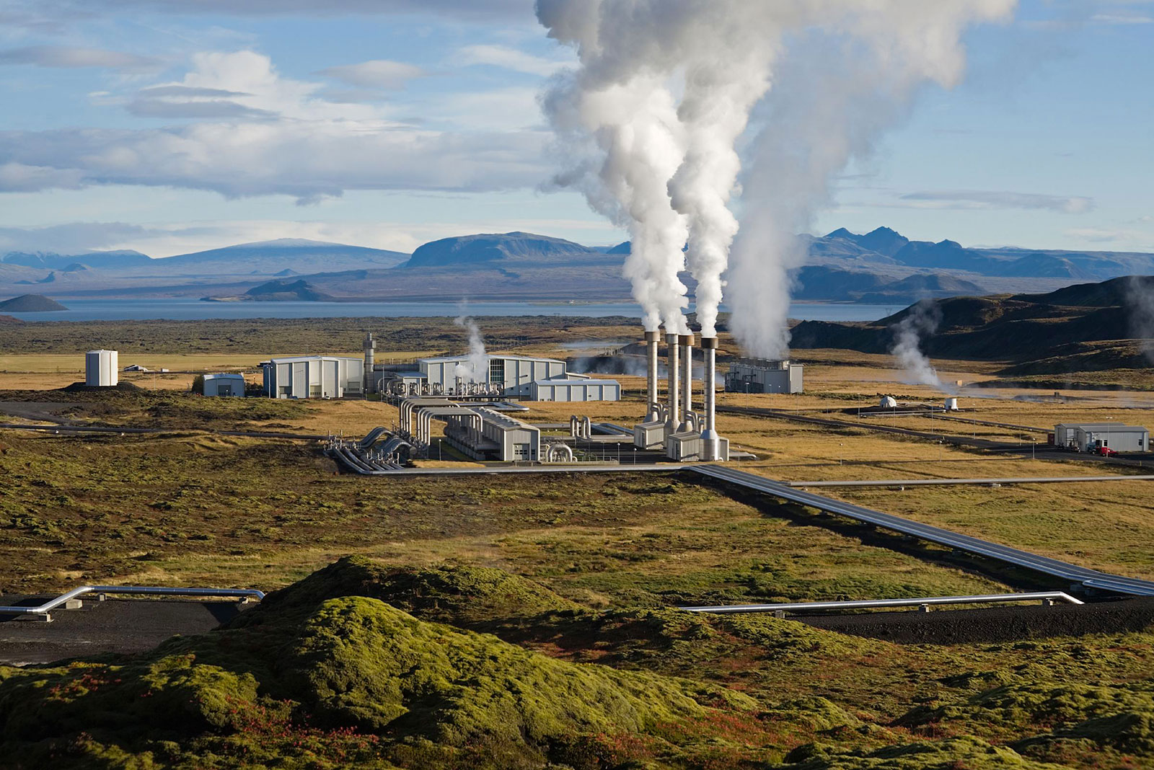
Geothermal Energy
Renewable Energy Technology

Slide 2
Definition
WHAT DOES THE WORD "GEOTHERMAL" MEAN?
Geo = Earth, Thermal = Heat
WHAT IS GEOTHERMAL ENERGY?
Energy that can be extracted from the heat in the earth
Conditions are most favorable for geothermal activity where the earth's tectonic plates collide, and one slides beneath another.
The best example of these hot regions is the Pacific Ring of Fire.

Slide 3
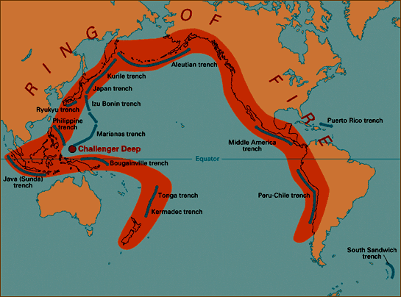
Geothermal Energy
Ring of Fire

Slide 4
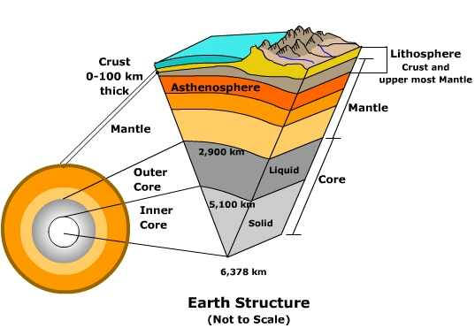
Geothermal Energy
Earth’s Structure

Slide 5
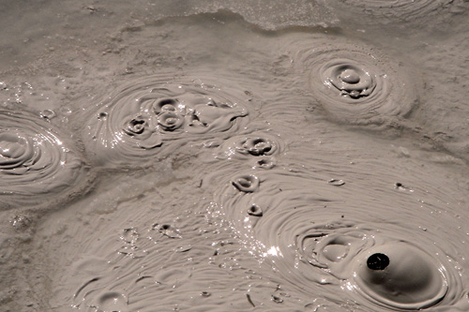
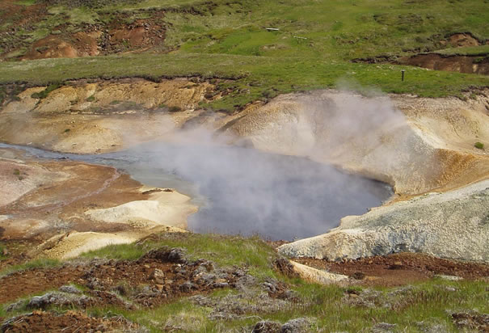
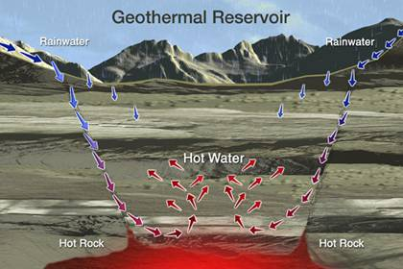
Geothermal Energy
How does geothermal heat get up to earth’s surface?
Conduction and Radiation: Heat from the Earth’s interior flows outward. It is transferred to the outer layer of rock or the crust.
Convection: In some regions, the mantle beneath the crust may be hot enough to partly melt and create magma. Magma rising upward out of the mantle can bring intense shallow heat into the crust.

Slide 6
Geothermal Energy
Classification of Geothermal Resources
By Type-
Low Enthalpy
Intermediate Enthalpy
High Enthalpy
By Source
Hot Dry Rock
Liquid-dominated
Vapor dominated
Geopressurized fluids
Magma

Slide 7
Geothermal Energy
Classification of Geothermal Resources
Liquid-dominated Resources:
These are the most commons of the hydrothermal resources.
In a liquid-dominated resource the water is the continuous phase.
It can be present as vapour but also as bubbles.
Depending on the temperature and pressure there is more or less vapour.
The pressure in these resources is fairly low typically 0.5 – 1 Mpa and the temperature is around 180^{O}C.

Slide 8
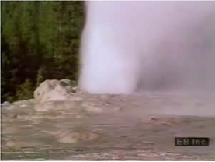
Geothermal Energy
Classification of Geothermal Resources
Vapour-dominated Systems:
Liquid water and vapour normally co-exist in the reservoir, with vapour as the continuous, pressure-controlling phase.
Geothermal systems of this type, the best-known of which are Larderello in Italy and the Geysers in California, are somewhat rare and are high temperature systems.
They normally produce dry-to-superheated steam.

Slide 9
Geothermal Energy
Classification of Geothermal Resources
Geo-pressurized Fluids:
Geo-pressurized geothermal systems are hot water reservoir (aquifer) mixed with dissolved gases like methane that can reach 200^{O}C and are under huge pressure (50-100 MPa).
The depth ranges from 3-6 km and are normally located in sedimentary formations.
The resource can be exploited for their thermal energy, calorific energy of gasses and hydraulic energy due to high pressure.
The price of electricity generated by geo-pressurized fluids is not competitive when compared with conventional resources.

Slide 10
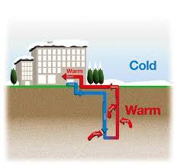
Geothermal Energy
Classification of Geothermal Resources
Hot Dry Rock (HDR):
High pressure water is pumped through a specially drilled well into a deep body or hot, compact rock causing its hydraulic fracturing.
The water permeates these artificial fractures, extracting heat from the surrounding rock, which acts as a natural reservoir. This ‘reservoir’ is later penetrated by a second well, which is used to extract the heated water.
The system therefore consists of (i) the borehole used for hydraulic fracturing, through which cold water is injected into (ii) the artificial reservoir and (iii) the borehole used to extract the hot water.

Slide 11
Geothermal Energy
Classification of Geothermal Resources
Magma:
These resources offer extremely high-temperature geothermal opportunities but existing technology does not allow recovery of heat.
However, in the future there might be available them the technology required to exploit these resources and thus might become an important resource of energy.

Slide 12
Geothermal Energy
Advantages:
Its reserves are enormous-virtually infinite on historical scale.
It is less polluting than combustible fuels or nuclear energy.
It is an indigenous resource that can be developed and make a country less reliant politically and economically and can alleviate the national balance of payments.
As a rule of thumb, one kilowatt of geothermal base load can substitute about 2 tons of oil annually.
It is highly versatile.
Unlike hydropower it is not subject to the variations of the weather.
It is not labour intensive. Once the exploitation of geothermal energy is established, it is thus less vulnerable to disputes such as say strikes in coal mining.

Slide 13
Geothermal Energy
Disadvantages:
There are no many places on the earth highly suitable for exploit. Most suited areas are on edges of the tectonic plates, namely areas of high volcanic and tectonic activity.
Expensive exploration
Brines are corrosive and poisonous
Complicated reservoir management
Sensitive to underground disturbances.

Slide 14
Geothermal Energy
Applications:
Uses of Geothermal Energy in the past?
Bathing: Ancient civilizations used hot springs for bathing
Medical Therapy: Early Romans used geothermal water to treat eye and skin disease
Cooking: Native Americans and others used geothermal water for cooking.
Heating: Early Romans used geothermal water to heat their homes in Pomeii.

Slide 15
Geothermal Energy
Geothermal Power Generation System:
Depend on the nature of the resource, meaning depends on the geothermal fluid:
Temperature
Pressure
Salinity
Content of other gases
Typical geothermal plant size: 20-60 Mwe
A geothermal system consists of three main elements:
A heat source
A reservoir and a fluid- the carrier for transferring heat from the source to the power plant
Power plant

Slide 16
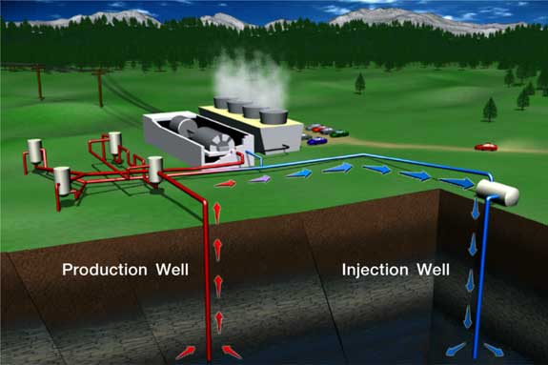
Geothermal Energy
Geothermal Power Generation System:

Slide 17
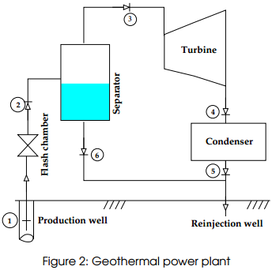
Geothermal Energy
Single-flash Steam Power Plants:
Mainstay of the geothermal power industry
The unit power capacity ranges from 3 to 90 MW
Typical steam conditions: 155-165 C and 5-6 bar
Design conditions: currently it is required about 8 kg steam per saleable kWh
Waste brine (unflashed) can be up to 80% of the fluid produced.
The waste brine is reinjected unless there is a direct heating application. Thus reinjection wells must be available for fluid disposal.

Slide 18
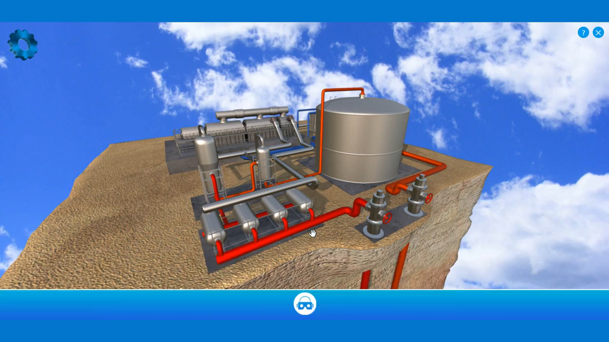
Geothermal Energy

Slide 19
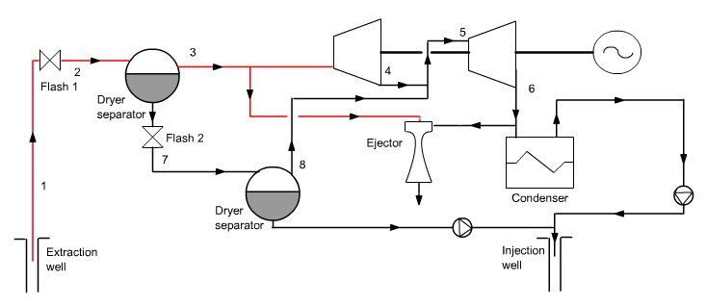
Geothermal Energy
Double-flash Steam Power Plants:
It is an improvement of the single-flash design. It can produce 15-20% more power output for the same geothermal fluid conditions.
Ideal where geothermal fluids contain low levels of impurities.
Raises the efficiency up to 20-25% and the plant cost only by 5%

Slide 20
Geothermal Energy
Double-flash Steam Power Plants:
It is an improvement of the single-flash design. It can produce 15-20% more power output for the same geothermal fluid conditions.
Ideal where geothermal fluids contain low levels of impurities.
Raises the efficiency up to 20-25% and the plant cost only by 5%

Slide 21
Geothermal Energy
Other Geothermal Power Plants
Dry Steam Power Plants
Binary Cycle Power Plants
Hybrid System
Direct Applications of Geothermal Energy
The most common non-electric use world-wide (in terms of installed capacity in 2005) was
Heat Pumps (54.4%)
Bathing (19.1%)
Space-heating (15.4%)
Greenhouses (5%)
Aquaculture (2.2%)
Industrial Processes (1.7%)
Others (2.2%)

Slide 22
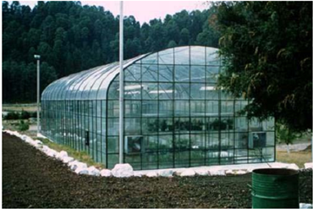
Geothermal Energy
Agricultural Applications:
The agricultural applications of geothermal fluids consist of open-field agriculture and greenhouse heating.
Thermal water can be used in open-field agriculture to irrigate and/or heat the soil.
The most common application of geothermal energy in agriculture is, in greenhouse heating.

Slide 23
Geothermal Energy
Industrial Use:
The entire temperature range of geothermal fluids, whether steam or water, can be exploited in industrial applications.
The different possible forms of utilization include:
Process heating
Evaporation
Drying
Distillation
Washing
De-icing
Salt Extraction

Slide 24
Reference
Lecture notes from Department of Energy Technology, KTH, Sweden
Wind Energy Explained: Theory, Design and Application, J. F. Manwell, Jon G. McGowan, Anthony L. Rogers, Wiley
Wind and Solar Power Systems (2nd edition), Mukund R. Patel, CRC press, USA.
Renewable and Efficient Electric Power Systems, Gilbert M. Masters, Wiley; 2 edition (June 24, 2013)

